Slide 1
Solving the Bounded Knapsack Problem with Genetic Algorithm
Reporter: 黃子睿 P76054088
朱宥誠 Q56051053
Team 9
Date: 2017/06/20

Slide 2
Outline
Introduction
Genetic Algorithm
Knapsack Problem
Implementation of the KP Using GA
Experimental Results
Discussion and Conclusion

Slide 3
Introduction
The Knapsack Problem is an example of a combinatorial optimization problem.
Genetic Algorithms search for good solutions to a problem from a large number of possible solutions.
In this project we use Genetic Algorithms (GA) to solve the bounded Knapsack Problem (KP).

Slide 4
Genetic Algorithm
Genetic algorithm (GA)
Inspired by the mechanics of natural evolution.
Main step
Start
Fitness
Create a new population
Replace
Test
Selection
Crossover
Mutation

Slide 5

Genetic Algorithm
Start: Randomly generate a population of N chromosomes.
Fitness: Calculate the fitness of all chromosomes.
Create a new population
Selection: According to the selection method select 2 chromosomes from the population.
Figure 1 Example of chromosomes.

Slide 6
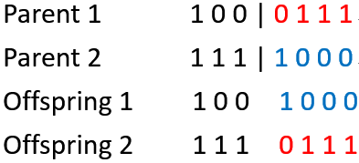
Genetic Algorithm
Create a new population
Crossover: Perform crossover on the 2 chromosomes selected.
Figure 2 Parents and a crossover point at position 3.

Slide 7

Genetic Algorithm
Create a new population
Mutation: Perform mutation on the chromosomes obtained.
Figure 3 Chromosome with mutation point at position 2.

Slide 8
Genetic Algorithm
Replace: Replace the current population with the new population.
Test: Test whether the end condition is satisfied. If so, stop. If not, return the best solution in current population and go to Step 2.

Slide 9
Knapsack Problem
Knapsack Problem
Given a set of items, each with a weight and a value.
Determine the number of each item to include in a collection so that the total weight is less than or equal to a given limit and the total value is as large as possible.
Unbounded knapsack problem
0/1 knapsack problem

Slide 10
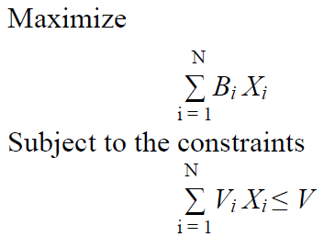

Knapsack Problem
Definition

Slide 11
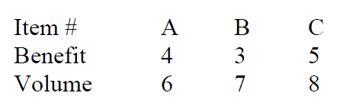
Knapsack Problem
Given a set of items, each with a weight and a value.
Table 1 Knapsack parameter.

Slide 12
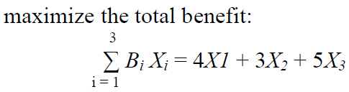
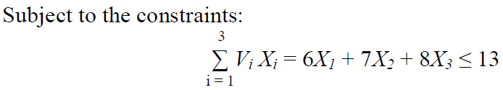

Knapsack Problem
Determine the number of each item to include in a collection so that the total weight is less than or equal to a given limit and the total value is as large as possible.

Slide 13
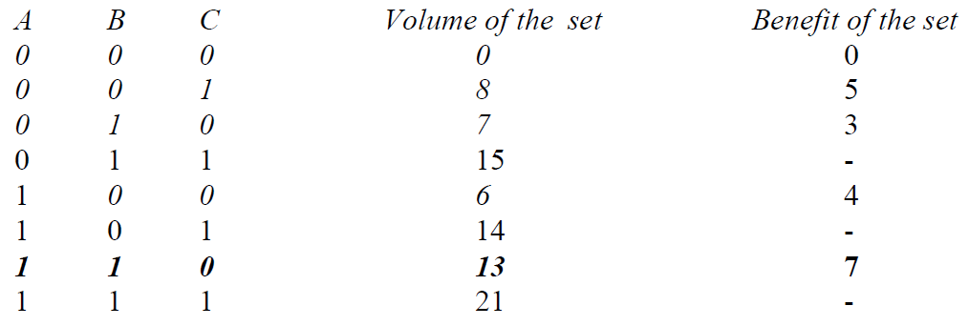

Knapsack Problem
For this problem there are $2^{3}$ possible subsets of items.
Table 2 Knapsack Problem with volume and benefit.

Slide 14
Implementation of the KP Using GA
START
Initialize array items reading from a file - the data (volume and benefit) for each item
Initialize the first population by randomly generating a population of Size chromosomes
Calculate the fitness and volume of all chromosomes
Randomly select 2 chromosomes from the population
Figure 4 Flowchart of the main program.

Slide 15
Implementation of the KP Using GA
Perform crossover on the 2 chromosomes selected
Perform mutation on the chromosomes obtained
Is the number of generations greater than the limit?
No
Yes
STOP
Figure 4 Flowchart of the main program.

Slide 16
Implementation of the KP Using GA
START
For each chromosome in the population do:
For each item in the chromosome if it is included in the knapsack, add its volume and benefit to the total volume and benefit
Is total volume > capacity of the knapsack
No
STOP
Yes
Randomly choose items from the chromosome and decrease items amounts
Figure 5 Flowchart of the fitness function.

Slide 17
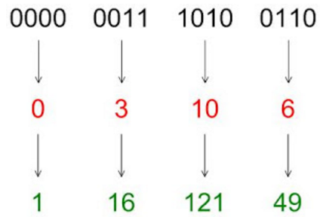
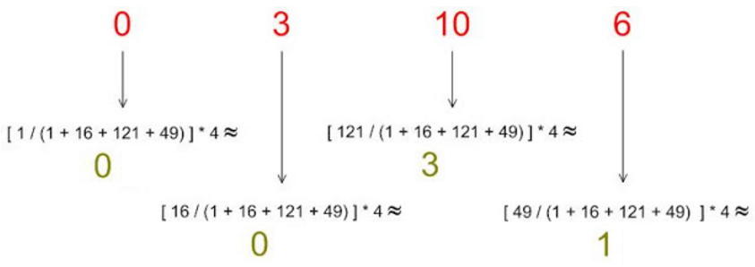

Implementation of the KP Using GA
Roulette-wheel selection
$\frac{Copy number}{Population number}=\frac{Fitness}{Sum of fitness}$
$Copy number=\frac{Fitness×Population number}{Sum of fitness}$
Figure 6 Roulette-wheel selection example.

Slide 18
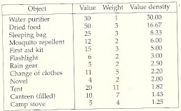

Experimental Results
Capacity of the knapsack$:20$
Bounded constraint: for all item $≤3$
Generation$:50,$Population$:50$
Crossover rate$:0.5,$ Mutation rate$:0.$1
Table 3 Knapsack parameter setting from book Computer Algorithms, E. Horowitz, S. Sahni and S. Rajasekaran.

Slide 19
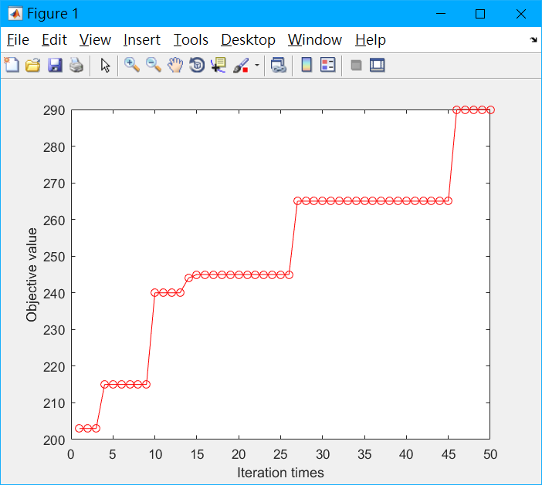
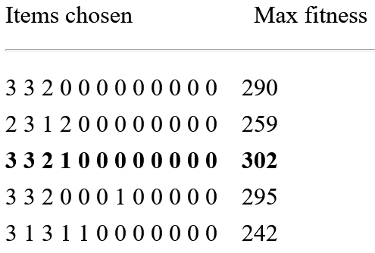
Experimental Results
Table 4 The KP solution with 5 times.
Figure 7 Convergence test of the GA to solve KP.

Slide 20
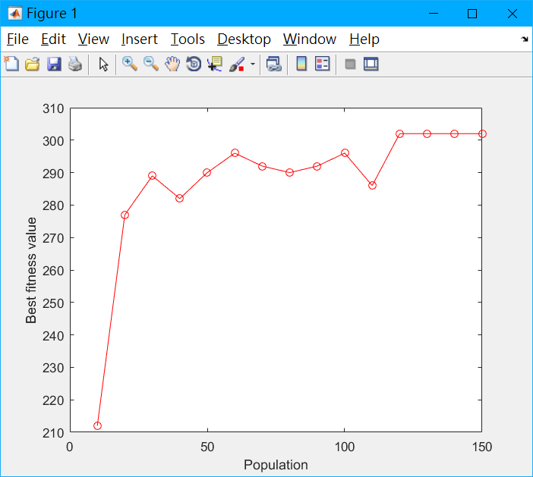
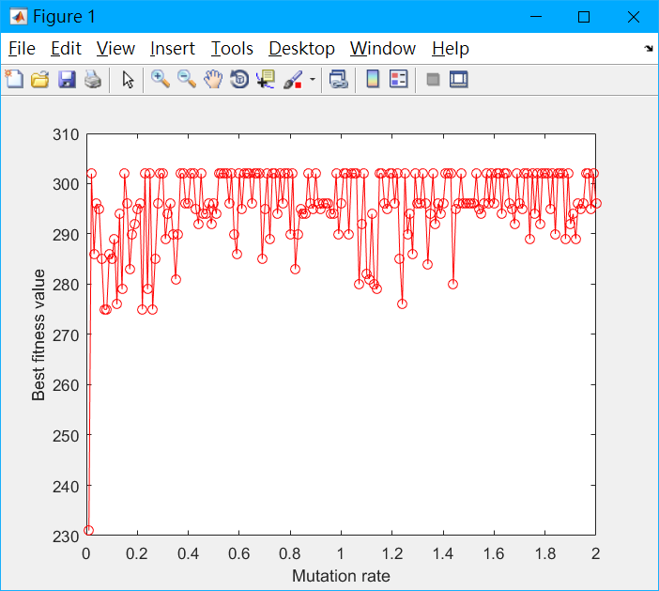
Experimental Results
Figure 8 The KP solution of GA with respect to different population.
Figure 9 The KP solution of GA with respect to different mutation rate.
Notes:
10

Slide 21
Discussion and Conclusion
We have shown how Genetic Algorithms can be used to find good solutions for the Bounded Knapsack Problem.
GA reduce the complexity of the KP from exponential to linear.
Increasing the population and generation is expected to get better results.

Slide 22
Thanks for Your Attendance!

